Slide 1


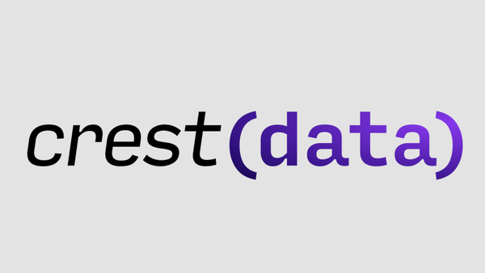


REDHAT HACKERS
Problem : Detect and Classify Malware Using Machine Learning
Team :
Parthivsinh Vaghela
Suraj Shah
Prinsh Bhanderi
Niraj Chaudhri
Kaushal Vala

Slide 2




Securing Systems using ML/AI -Malware Detection
Detect and Classify Malware Using Machine Learning

Slide 3


Introduction
Understanding Malware Analysis
Static Analysis: Extracting file structures, headers, and metadata.
Dynamic Analysis: Observing runtime behaviors such as API calls and DLL imports.
Why AI-Based Detection?
AI models can recognize hidden patterns in malware behavior.
Automated classification is faster and more scalable than manual inspection.
Our Innovation:
A hybrid approach combining feature selection, dimensionality reduction, and ensemble learning for malware classification.

Slide 4

Proposed Approach
Proposed Approach
1. Data Collection & Preprocessing
Datasets Used:
Portable Executable (PE) Header Dataset: (52 fields, 10 sections).
DLL Imports Dataset: (DLLs used by each malware family).
API Calls Dataset: (API functions invoked by malware samples).
3. Data Merging and Grouping
Used SHA-256 as the common key to merge datasets. Applied pandas groupby() to consolidate information per malware sample.
4. Model Training with XGBoost
Algorithm Used: XGBoost (Extreme Gradient Boosting)
Why XGBoost?
Handles large datasets efficiently.
Prevents overfitting with built-in regularization.
Optimized for structured data classification tasks.
Final Accuracy Achieved: 89%
2. Feature Selection Using Random Forest
Reduced features for efficiency while maintaining accuracy:
PE Headers → 42 features
DLL Imports → 50 features
API Calls → 1,772 features

Slide 5
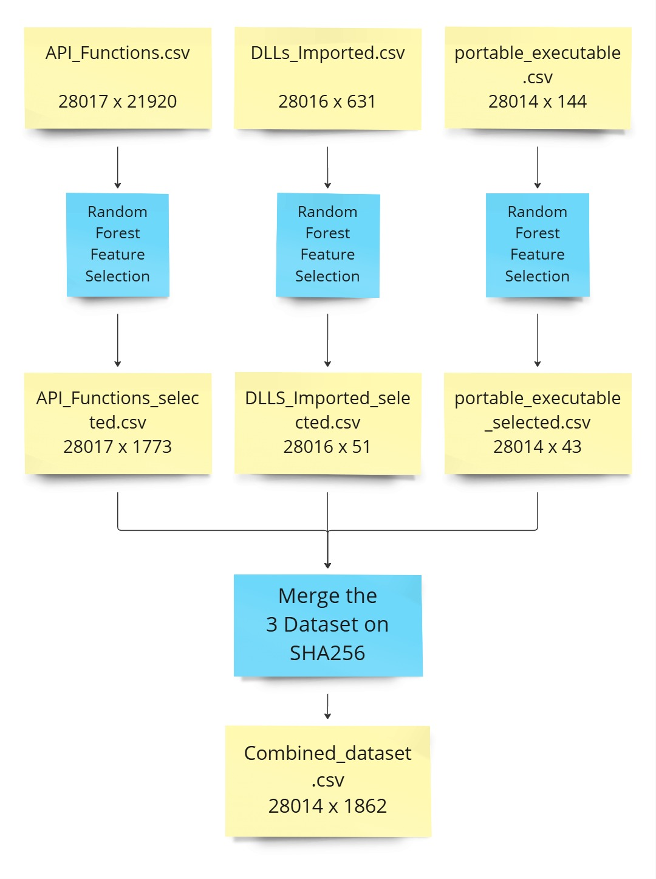

Flowchart of Data
Processing

Slide 6


Our Explorations
Results:
XGBoost:
XGBoost offers the best overall performance, achieving the highest accuracy (89.57%). It demonstrates a strong balance across all metrics, including precision, recall, and F1-score, making it the most reliable model for the given task. The model excels in handling complex data patterns, ensuring high performance even across less represented classes.
Random Forest:
The Random Forest classifier follows closely behind XGBoost with an accuracy of 88.13%. It is a strong performer, but slightly lags in recall, particularly for classes 5 and 6. Despite this, it remains a reliable model due to its ensemble nature, which helps mitigate overfitting and ensures robust predictions.
Decision Tree:
The Decision Tree classifier has the lowest overall performance with an accuracy of 87.26%. It struggles with recall for certain classes, especially class 3. While it is simple and interpretable, it tends to overfit the data, leading to lower performance when compared to the more complex models like XGBoost and Random Forest.

Slide 7

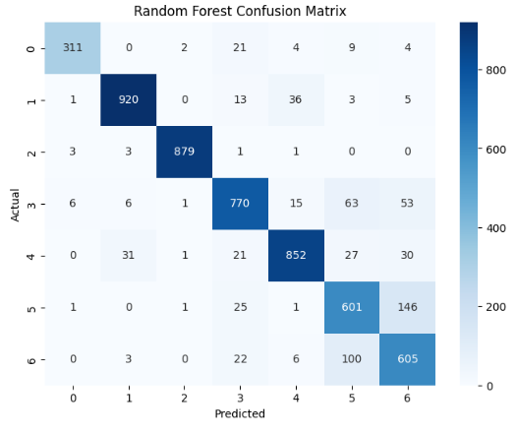
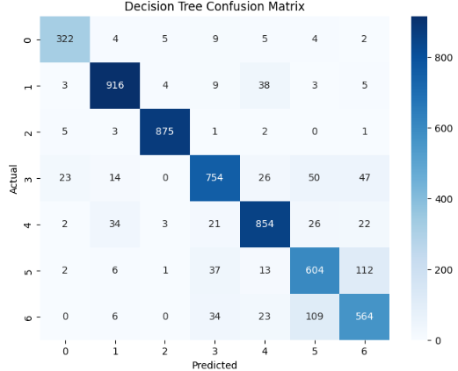
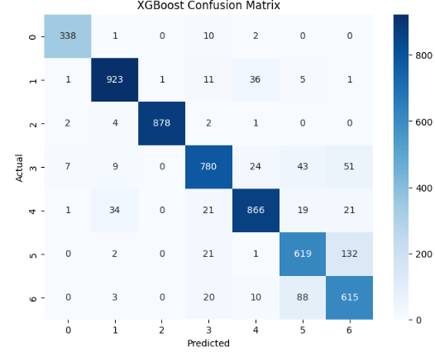
Confusion Metrics

Slide 8


Why Choose Our Solution?
Key Advantages of Our Approach:
High Accuracy: Achieved 89% malware detection accuracy
Efficient Feature Selection: Feature reduction led to optimized performance.
Scalable & Fast: Handles large datasets with efficient preprocessing.
Practical and Scalable for Real-World Use
Our approach optimizes feature selection to balance accuracy and performance.
Works on large-scale malware datasets, making it adaptable for real-world cybersecurity applications.

Slide 9
Limitations
Challenges and Edge Cases
Adversarial Attacks: Attackers may craft samples to evade detection. Evolving Malware: Needs regular retraining to detect new threats. Dependency on Quality of Data: Performance depends on dataset quality and diversity.
Future Work to Overcome Limitations
Real-time Analysis: Integrating dynamic behavior-based detection. Continuous Learning: Implementing online learning techniques.

